Slide 1
NP-COMPLETENESS

Slide 2
P problem vs Probably not P problem
Q. Which problems will we be able to solve in practice?
A working definition. [Cobham 1964, Edmonds 1965, Rabin 1966] Those with polynomial-time algorithms.
Yes
Probably no
Shortest path
Longest path
Matching
3D-matching
Min cut
Max cut
2-SAT
3-SAT
Planar 4-color
Planar 3-color
Bipartite vertex cover
Vertex cover
Primality testing
Factoring

Slide 3
Classify the problems
Desiderata. Classify problems according to those that can be solved in polynomial-time and those that cannot.
Provably requires exponential-time.
  Given a Turing machine, does it halt in at most k steps?
  Given a board position in an n-by-n generalization of chess, can black guarantee a win?
Bad news. Huge number of fundamental problems have defied classification for decades.
Good news. These problems are "computationally equivalent" and appear to be different manifestations of one really hard problem.

Slide 4
Reduction: polynomial-Time
Desiderata. Suppose we could solve X in polynomial-time. What else could we solve in polynomial time?
Reduction. Problem X polynomial reduces to problem Y if arbitrary instances of problem X can be solved using:
  Polynomial number of standard computational steps, plus
  Polynomial number of calls to oracle that solves problem Y.
Notation. X ≤ _{P} Y.
don't confuse with reduces from
computational model supplemented by special piece
of hardware that solves instances of Y in a single step

Slide 5
Reduction
Purpose. Classify problems according to relative difficulty.
Design algorithms. If X ≤ _{P} Y and Y can be solved in polynomial-time, then X can also be solved in polynomial time.
Establish intractability. If X ≤ _{P} Y and X cannot be solved in polynomial-time, then Y cannot be solved in polynomial time.
e.g. solving equations P1: ax+b=c vs P2: dx^2+ax+b=c
Establish equivalence. If X ≤ _{P} Y and Y ≤ _{P} X, we use notation X ≡ _{P} Y.
up to cost of reduction

Slide 6
Reduction By Simple Equivalence
Basic reduction strategies.
  Reduction by simple equivalence.
  Reduction from special case to general case.
  Reduction by encoding with gadgets.

Slide 7
Example 1: Independent Set vs clique
INDEPENDENT SET: Given a graph G = (V, E) and an integer k, is there a subset of vertices S ⊆ V such that |S| ≥ k, and for each edge at most one of its endpoints is in S?
Ex. Is there an independent set of size ≥ 6? Yes.
Ex. Is there an independent set of size ≥ 7? No.
independent set
Notes:
Application: find set of mutually non-conflicting points

Slide 8
Clique
CLIQUE ≡_{P} INDEPENDENT-SET
Clique: Given a graph G = (V, E) and an integer k, is there a subset of vertices S ⊆ V such that |S| ≥ k, and for each pair (x, y) of points in S, (x, y) is an edge of E?
Claim. CLIQUE ≡_{P} INDEPENDENT-SET.
Pf. We show S is an independent set of G iff S is a clique of G’, where G’ is the complement of G: G’ = (V, V² – E).
Notes:
Application: find set of mutually non-conflicting points

Slide 9
Example 2: Vertex Cover vs IS
VERTEX COVER: Given a graph G = (V, E) and an integer k, is there a subset of vertices S ⊆ V such that |S| ≤ k, and for each edge, at least one of its endpoints is in S?
Ex. Is there a vertex cover of size ≤ 4? Yes.
Ex. Is there a vertex cover of size ≤ 3? No.
vertex cover
Notes:
TOY application = art gallery problem: place guards within an art gallery so that all corridors are visible at any time

Slide 10
Vertex Cover and Independent Set
VERTEX-COVER ≡_{P} INDEPENDENT-SET
Claim. VERTEX-COVER ≡_{P} INDEPENDENT-SET.
Pf. We show S is an independent set iff V − S is a vertex cover.
independent set
vertex cover

Slide 11
Vertex Cover and Independent Set
VERTEX-COVER ≡_{P} INDEPENDENT-SET
Claim. VERTEX-COVER ≡_{P} INDEPENDENT-SET.
Proof. We show S is an independent set iff V − S is a vertex cover.
⇒
  Let S be any independent set.
  Consider an arbitrary edge (u, v).
  S independent ⇒ u ∉ S or v ∉ S ⇒ u ∈ V − S or v ∈ V − S.
  Thus, V − S covers (u, v).
⇐
  Let V − S be any vertex cover.
  Consider two nodes u ∈ S and v ∈ S.
  Observe that (u, v) ∉ E since V − S is a vertex cover.
  Thus, no two nodes in S are joined by an edge ⇒ S independent set. ▪

Slide 12
Definition of NP

Slide 13
Decision Problems
Decision problem. Def.
  X is a set of strings.
  Instance: string s.
  Algorithm A solves problem X: A(s) = yes iff s ∈ X.
Polynomial time. Algorithm A runs in poly-time if for every string s, A(s) terminates in at most p(|s|) "steps", where p(⋅) is some polynomial.
PRIMES. X = { 2, 3, 5, 7, 11, 13, 17, 23, 29, 31, 37, …. }
Algorithm. [Agrawal-Kayal-Saxena, 2002] p(|s|) = |s|⁸.
length of s

Slide 14
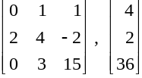
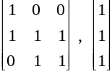
Definition of P
P. Decision problems for which there is a poly-time algorithm.
Problem | Description | Algorithm | Yes | No
MULTIPLE | Is x a multiple of y? | Grade school division | 51, 17 | 51, 16
RELPRIME | Are x and y relatively prime? | Euclid (300 BCE) | 34, 39 | 34, 51
PRIMES | Is x prime? | AKS (2002) | 53 | 51
EDIT-DISTANCE | Is the edit distance between x and y less than 5? | Dynamic programming | niether neither | acgggt ttttta
LSOLVE | Is there a vector x that satisfies Ax = b? | Gauss-Edmonds elimination

Slide 15
NP
Certification algorithm intuition.
  Certifier views things from "managerial" viewpoint.
  Certifier: doesn't determine whether s ∈ X on its own;
  rather, it checks a proposed proof t that s ∈ X.
Def. Algorithm C(s, t) is a certifier for problem X if for every string s, s ∈ X iff there exists a string t such that C(s, t) = yes.
NP. Decision problems for which there exists a poly-time certifier.
Remark. NP stands for nondeterministic polynomial-time.
"certificate" or "witness"
C(s, t) is a poly-time algorithm and
|t| ≤ p(|s|) for some polynomial p(⋅).

Slide 16
Certifiers and Certificates: EX1. Composite
COMPOSITES. Given an integer s, is s composite?
Certificate. A nontrivial factor t of s. Note that such a certificate exists iff s is composite. Moreover |t| ≤ |s|.
Certifier.
Instance. s = 437,669.
Certificate. t = 541 or 809.
Conclusion. COMPOSITES is in NP.
boolean C(s, t) {
if (t ≤ 1 or t ≥ s)
return false
else if (s is a multiple of t)
return true
else
return false
}
437,669 = 541 × 809

Slide 17



Ex2. Satisfiability
Literal. A Boolean variable or its negation.
Clause. A disjunction of literals.
Conjunctive normal form. A propositional
formula Φ that is the conjunction of clauses.
SAT. Given CNF formula Φ, does it have a satisfying truth assignment?
3-SAT. SAT where each clause contains exactly 3 literals.
each corresponds to a different variable
Ex.
Yes. x₁ = true, x₂ = true x₃ = false.
Notes:
Any logical formula can be expressed in CNF.

Slide 18
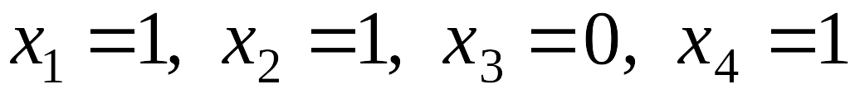
3-Satisfiability
SAT. Given a CNF formula Φ, is there a satisfying assignment?
Certificate. An assignment of truth values to the n boolean variables.
Certifier. Check that each clause in Φ has at least one true literal.
Ex.
Conclusion. SAT is in NP.
instance s
certificate t

Slide 19
Ex3. Hamiltonian Cycle
HAM-CYCLE. Given an undirected graph G = (V, E), does there exist a simple cycle C that visits every node?
Certificate. A permutation of the n nodes.
Certifier. Check that the permutation contains each node in V exactly once, and that there is an edge between each pair of adjacent nodes in the permutation.
Conclusion. HAM-CYCLE is in NP.
instance s
certificate t

Slide 20
P, NP, EXP
P. Decision problems for which there is a poly-time algorithm.
EXP. Decision problems for which there is an exponential-time algorithm.
NP. Decision problems for which there is a poly-time certifier.
Claim. P ⊆ NP.
Pf. Consider any problem X in P.
  By definition, there exists a poly-time algorithm A(s) that solves X.
  Certificate: t = ε, certifier C(s, t) = A(s). ▪
Claim. NP ⊆ EXP.
Pf. Consider any problem X in NP.
  By definition, there exists a poly-time certifier C(s, t) for X.
  To solve input s, run C(s, t) on all strings t with |t| ≤ p(|s|).
  Return yes, if C(s, t) returns yes for any of these. ▪
Notes:
epsilon = empty string

Slide 21
Does P=NP?
The (literally) $1,000,000 question

Slide 22
The Main Question: P Versus NP
Does P = NP? [Cook 1971, Edmonds, Levin, Yablonski, Gödel]
  Is the decision problem as easy as the certification problem?
  Clay $1 million prize.
If yes: Efficient algorithms for 3-COLOR, TSP, FACTOR, SAT, …
If no: No efficient algorithms possible for 3-COLOR, TSP, SAT, …
Consensus opinion on P = NP? Probably no.
EXP
NP
EXP
P
P = NP
If P ≠ NP
If P = NP
would break RSA cryptography
(and potentially collapse economy)
Notes:
Cook formulated conjecture explicitly, others presented close approximations
“ The classes of problems which are respectively known and not known to have good algorithms are of great theoretical interest…. I conjecture that there is no good algorithm for the traveling salesman problem. My reasons are the same as for any mathematical conjecture: (i) It is a legitimate mathematical possibility and (ii) I do not know.” -- Jack Edmonds, 1966
If no, then computer scientists can say "I told you so"

Slide 23
NP-hard: If you can solve it, you can solve everything in NP by polynomial reduction.
NP-complete: NP-hard and in NP
Is there a Hamilton cycle (tour that visits each vertex exactly once)?

Slide 24
Def. NP-Hard and NP-Complete
NP-hard. A problem Y is NP-hard if, for every problem X in NP, X ≤ _{p} Y.
NP-complete. A problem Y is NP-complete, if it is NP-hard and in NP.
Theorem. Suppose Y is an NP-complete problem. Then Y is solvable in poly-time iff P = NP.
Pf. ⇐ If P = NP then Y can be solved in poly-time since Y is in NP.
Pf. ⇒ Suppose Y can be solved in poly-time.
  Let X be any problem in NP. Since X ≤ _{p} Y, we can solve X in
  poly-time. This implies NP ⊆ P.
  We already know P ⊆ NP. Thus P = NP. ▪
Fundamental question. Do there exist "natural" NP-complete problems?
Notes:
why couldn't there be incomparable problems such that neither X <= Y nor Y <= X ?

Slide 25
NP-hard
Hamilton cycle
Steiner tree
Graph 3-coloring
Satisfiability
Maximum clique
…
NP-complete
Matrix permanent
Halting problem
…
NP
Factoring
Graph isomorphism
Minimum circuit size
…
Graph connectivity
Primality testing
Matrix determinant
Linear programming
…
P

Slide 26
First NPC: Circuit Satisfiability
CIRCUIT-SAT. Given a combinational circuit built out of AND, OR, and NOT gates, is there a way to set the circuit inputs so that the output is 1?
output
∧
¬
∧
yes: 1 0 1
∧
∨
∨
1
0
?
?
?
hard-coded inputs
inputs

Slide 27
Proof sketch
Theorem. CIRCUIT-SAT is NP-complete. [Cook 1971, Levin 1973]
Pf. (sketch)
  Any algorithm that takes a fixed number of bits n as input and produces a yes/no answer can be represented by such a circuit.
  Moreover, if algorithm takes poly-time, then circuit is of poly-size.
  Consider some problem X in NP. It has a poly-time certifier C(s, t).
  To determine whether s is in X, need to know if there exists a certificate t of length p(|s|) such that C(s, t) = yes.
  View C(s, t) as an algorithm on |s| + p(|s|) bits (input s, certificate t) and convert it into a poly-size circuit K.
    first |s| bits are hard-coded with s
    remaining p(|s|) bits represent bits of t
  Circuit K is satisfiable iff C(s, t) = yes.
sketchy part of proof; fixing the number of bits is important,
and reflects basic distinction between algorithms and circuits
Notes:
intellectual milestone in CS
by Savage's theorem, P = languages with uniformly polynomial circuits

Slide 28
Reduction review
Basic reduction strategies.
  Simple equivalence: INDEPENDENT-SET ≡ _{P} VERTEX-COVER.
  Special case to general case: VERTEX-COVER ≤ _{P} SET-COVER.
  Encoding with gadgets: 3-SAT ≤ _{P} INDEPENDENT-SET.
Transitivity. If X ≤ _{P} Y and Y ≤ _{P} Z, then X ≤ _{P} Z.
Pf idea. Compose the two algorithms.
Ex: 3-SAT ≤ _{P} INDEPENDENT-SET ≤ _{P} VERTEX-COVER ≤ _{P} SET-COVER.
Notes:
Proof idea for transitivity: compose the two algorithms.
Given an oracle for Z, can solve instance of X:
run the algorithm for X using a oracle for Y
each time oracle for Y is called, simulate it in a polynomial number of steps by using algorithm for Y, plus oracle calls to Z

Slide 29
NP-Completeness
Observation. All problems below are NP-complete and polynomial reduce to one another!
by definition of NP-completeness
CIRCUIT-SAT
3-SAT
3-SAT reduces to INDEPENDENT SET
INDEPENDENT SET
DIR-HAM-CYCLE
GRAPH 3-COLOR
SUBSET-SUM
VERTEX COVER
HAM-CYCLE
PLANAR 3-COLOR
SCHEDULING
SET COVER
TSP
Notes:
Karp analyzed most juicy open problem in discrete math – showed most were NP-complete
x -> y means x reduces to y (if you can solve y, then you can solve x)
Then to join the NP complete club, you need a reduction from SAT (or any other current member) to you

Slide 30
Some NP-Complete Problems
Six basic genres of NP-complete problems and paradigmatic examples.
  Packing problems: SET-PACKING, INDEPENDENT SET.
  Covering problems: SET-COVER, VERTEX-COVER.
  Constraint satisfaction problems: SAT, 3-SAT, Integer Programming.
  Sequencing problems: HAMILTONIAN-CYCLE, TSP.
  Partitioning problems: 3D-MATCHING, 3-COLOR.
  Numerical problems: SUBSET-SUM, KNAPSACK.
Practice. Most NP problems are either known to be in P or NP-complete.
Notable exceptions. Factoring, graph isomorphism.
Notes:
Nash equilibria in two-person non-zero-sum game always exist, but major open question to *find* such a solution in poly-time. [Is there a corresponding decision problem or is only the search problem interesting from a computational complexity viewpoint?]

Slide 31
Extent and Impact of NP-Completeness
Extent of NP-completeness. [Papadimitriou 1995]
  Prime intellectual export of CS to other disciplines.
  6,000 citations per year (title, abstract, keywords).
    more than "compiler", "operating system", "database"
  Broad applicability and classification power.
  "Captures vast domains of computational, scientific, mathematical endeavors, and seems to roughly delimit what mathematicians and scientists had been aspiring to compute feasibly."
Notes:
Ernst Ising proposed simple model for phase transitions that is of fundamental importance in physics.
One of most exiting periods in statistical mechanics when Norwegian chemist Lars Onsager (and Nobel laureate) discovered solution to Ising model of ferromagnetism on 2D lattice.
Result energized many of the most brilliant physicist and mathematicians for solution to more realistic 3D model.
Spin glass Ising model from statistical mechanics (2d version unrealistic, 3d is the one everyone wanted to sovle)

Slide 32
More Hard Computational Problems
Aerospace engineering: optimal mesh partitioning for finite elements.
Biology: protein folding.
Chemical engineering: heat exchanger network synthesis.
Civil engineering: equilibrium of urban traffic flow.
Economics: computation of arbitrage in financial markets with friction.
Electrical engineering: VLSI layout.
Environmental engineering: optimal placement of contaminant sensors.
Financial engineering: find minimum risk portfolio of given return.
Genomics: phylogeny reconstruction.
Mechanical engineering: structure of turbulence in sheared flows.
Medicine: reconstructing 3-D shape from biplane angiocardiogram.
Operations research: optimal resource allocation.
Physics: partition function of 3-D Ising model in statistical mechanics.
Politics: Shapley-Shubik voting power.
Pop culture: Minesweeper consistency.
Statistics: optimal experimental design.

Slide 33
The Main Question: P Versus NP
Does P = NP? [Cook 1971, Edmonds, Levin, Yablonski, Gödel]
  Is the decision problem as easy as the certification problem?
  Clay $1 million prize.
If yes: Efficient algorithms for 3-COLOR, TSP, FACTOR, SAT, …
If no: No efficient algorithms possible for 3-COLOR, TSP, SAT, …
Consensus opinion on P = NP? Probably no.
EXP
NP
EXP
P
P = NP
If P ≠ NP
If P = NP
would break RSA cryptography
(and potentially collapse economy)

Slide 34
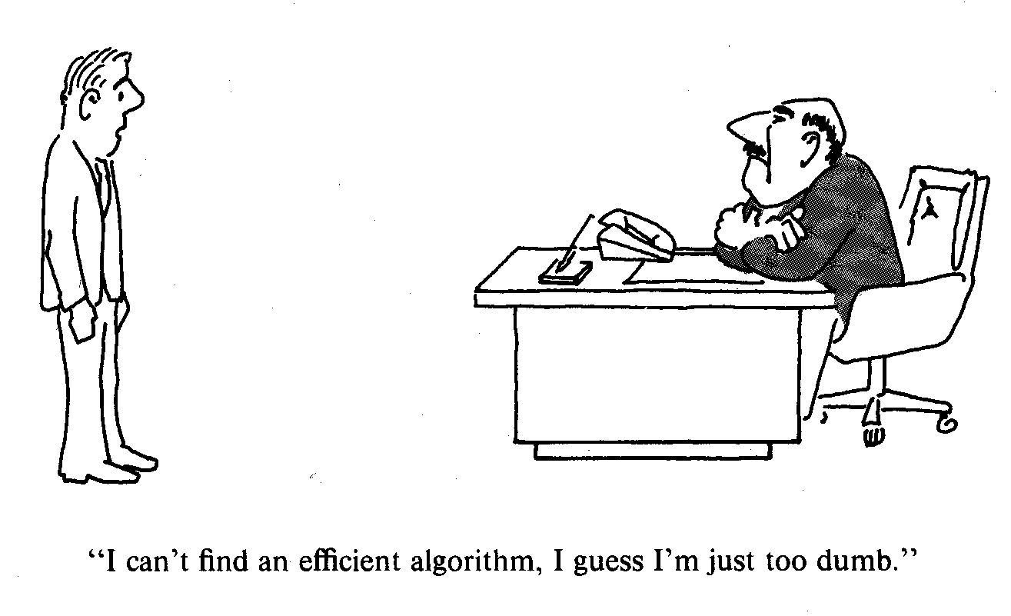
Practical Applications of NP-Completeness

Slide 35
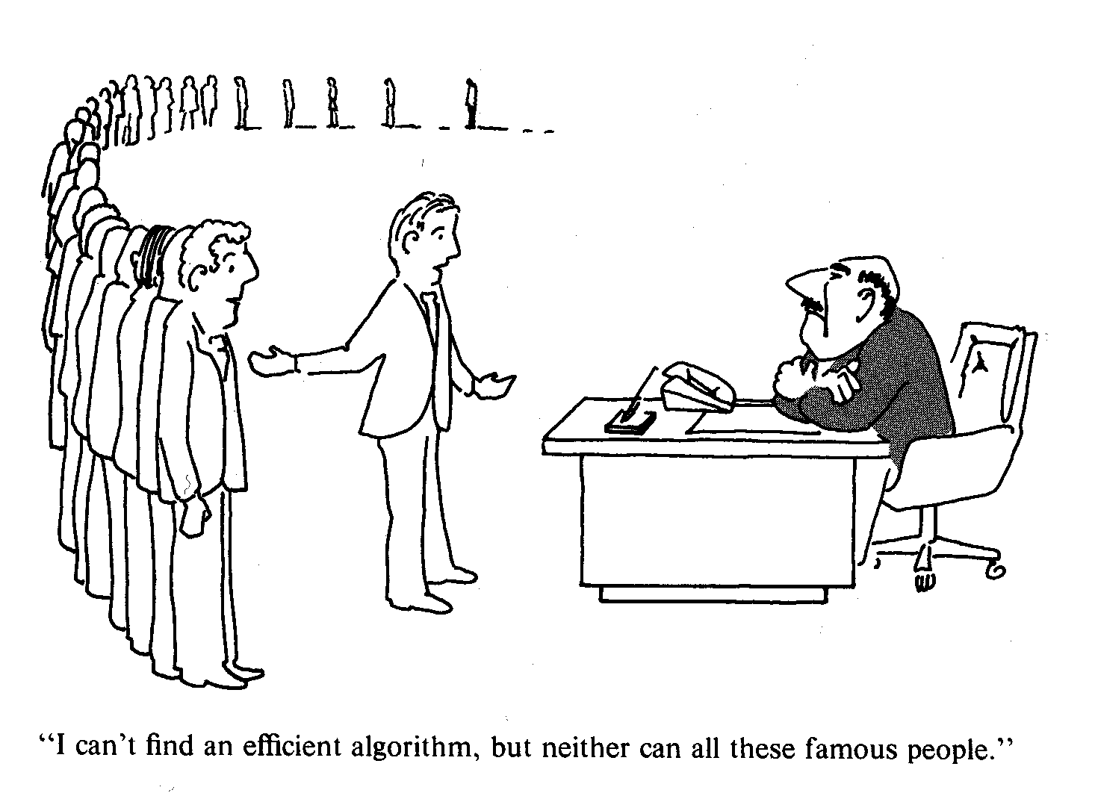
Practical Applications of NP-Completeness
I can’t find an efficient algorithm, but neither can all these famous people.
[Garey & Johnson, Computers and Intractability: A Guide to the Theory of NP-Completeness, Freeman, 1979.]

Slide 36
Reductions

Slide 37
Reduction from Special Case to General Case
Basic reduction strategies.
  Reduction by simple equivalence.
  Reduction by encoding with gadgets.
    3SAT-> IS
    3SAT->VC
    3SAT->Hamilton
  Reduction from special case to general case.

Slide 38
Example: Independent Set
INDEPENDENT SET. Given a graph G = (V, E) and an integer k, is there a subset of vertices S ⊆ V such that |S| ≥ k, and for each edge at most one of its endpoints is in S?
Ex. Is there an independent set of size ≥ 6? Yes.
Ex. Is there an independent set of size ≥ 7? No.
independent set
Notes:
Application: find set of mutually non-conflicting points

Slide 39

Example
Ex. Construction below creates a circuit K whose inputs can be set so that K outputs true iff graph G has an independent set of size 2.
∧
independent set of size 2?
independent set?
¬
both endpoints of some edge have been chosen?
∨
∨
∨
set of size 2?
∧
∧
∧
∨
u
∧
∧
∧
v
w
G = (V, E), n = 3
u-v
u-w
v-w
u
v
w
1
0
1
?
?
?
hard-coded inputs (graph description)
n inputs (nodes in independent set)

Slide 40
Establishing NP-Completeness
Remark. Once we establish first "natural" NP-complete problem,
others fall like dominoes.
Recipe to establish NP-completeness of problem Y.
  Step 1. Show that Y is in NP.
  Step 2. Choose an NP-complete problem X.
  Step 3. Prove that X ≤ _{p} Y.
Justification. If X is an NP-complete problem, and Y is a problem in NP with the property that X ≤ _{P} Y then Y is NP-complete.
Pf. Let W be any problem in NP. Then W ≤ _{P} X ≤ _{P} Y.
  By transitivity, W ≤ _{P} Y.
  Hence Y is NP-complete. ▪
by definition of
NP-complete
by assumption

Slide 41
Satisfiability
Literal: A Boolean variable or its negation.
Clause: A disjunction of literals.
Conjunctive normal form: A propositional
formula Φ that is the conjunction of clauses.
SAT: Given CNF formula Φ, does it have a satisfying truth assignment?
3-SAT: SAT where each clause contains exactly 3 literals.
each corresponds to a different variable
Ex:
Yes: x₁ = true, x₂ = true x₃ = false.
Notes:
Any logical formula can be expressed in CNF.

Slide 42




3-SAT is NP-Complete
CIRCUIT-SAT ≤ _{P} 3-SAT
Theorem. 3-SAT is NP-complete.
Pf. Suffices to show that CIRCUIT-SAT ≤ _{P} 3-SAT since 3-SAT is in NP.
  Let K be any circuit.
  Create a 3-SAT variable x_{i} for each circuit element i.
  Make circuit compute correct values at each node:
    x₂ = ¬ x₃ ⇒ add 2 clauses:
    x₁ = x₄ ∨ x₅ ⇒ add 3 clauses:
    x₀ = x₁ ∧ x₂ ⇒ add 3 clauses:
  Hard-coded input values and output value.
    x₅ = 0 ⇒ add 1 clause:
    x₀ = 1 ⇒ add 1 clause:
  Final step: turn clauses of length < 3 into
  clauses of length exactly 3 by introducing new
  variables. ▪
output
x₀
∧
x₁
x₂
∨
¬
x₅
x₄
x₃
0
?
?

Slide 43






3-SAT Reduces to Independent Set
3-SAT ≤ _{P} INDEPENDENT-SET
Claim. 3-SAT ≤ _{P} INDEPENDENT-SET.
Pf. Given an instance Φ of 3-SAT, we construct an instance (G, k) of INDEPENDENT-SET that has an independent set of size k iff Φ is satisfiable.
Construction.
  G contains 3 vertices for each clause, one for each literal.
  Connect 3 literals in a clause in a triangle.
  Connect literal to each of its negations.
G
k = 3

Slide 44
3-SAT Reduces to Independent Set
Claim. G contains independent set of size k = |Φ| iff Φ is satisfiable.
Pf. ⇒ Let S be independent set of size k.
  S must contain exactly one vertex in each triangle.
  Set these literals to true.
  Truth assignment is consistent and all clauses are satisfied.
Pf ⇐ Given satisfying assignment, select one true literal from each triangle. This is an independent set of size k. ▪
and any other variables in a consistent way
G
k = 3

Slide 45
Using the previous theorem,
we will prove that 2 problems
are NP-complete:
Vertex-Cover
to Hamiltonian-Path
Costas Busch - RPI
Fall 2006

Slide 46

Vertex Cover
Vertex cover of a graph
is a subset of nodes such that every edge
in the graph touches one node in
Example:
S = red nodes
Fall 2006
Costas Busch - RPI

Slide 47
Size of vertex-cover
is the number of nodes in the cover
Example:
|S|=4
Fall 2006
Costas Busch - RPI

Slide 48




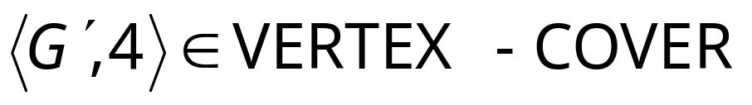
Corresponding language:
VERTEX-COVER = { :
graph contains a vertex cover
of size }
Example:
Costas Busch - RPI
Fall 2006

Slide 49
Theorem:
VERTEX-COVER is NP-complete
3CNF-SAT to VERTEX-COVER
Proof:
1. VERTEX-COVER is in NP
Can be easily proven
2. We will reduce in polynomial time
3CNF-SAT to VERTEX-COVER
(NP-complete)
Costas Busch - RPI
Fall 2006

Slide 50



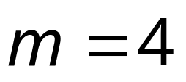
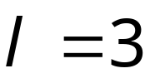
Let be a 3CNF formula
with variables
and clauses
Example:
Clause 1
Clause 2
Clause 3
Costas Busch - RPI
Fall 2006

Slide 51


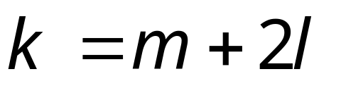
Formula can be converted
to a graph such that:
is satisfied
if and only if
Contains a vertex cover
of size
Idea:
An instance of 3-sat → generated a graph G
so that covered with m+2l nodes
Fall 2006

Slide 52











Clause 1
Clause 2
Clause 3
Variable Gadgets
nodes
Clause Gadgets
nodes
Clause 1
Clause 2
Clause 3
Costas Busch - RPI
Fall 2006

Slide 53
Clause 1
Clause 2
Clause 3
Clause 1
Clause 2
Clause 3
Costas Busch - RPI
Fall 2006

Slide 54
First direction ➔ in proof:
If is satisfied,
then contains a vertex cover of size
3-sat satisfiable → ‘generated G’ can be covered with m+2l nodes
Costas Busch - RPI
Fall 2006

Slide 55

Example:
Satisfying assignment
We will show that contains
a vertex cover of size
Costas Busch - RPI
Fall 2006

Slide 56
Put every satisfying literal in the cover
Costas Busch - RPI
Fall 2006

Slide 57
Select one satisfying literal in each clause gadget
and include the remaining literals in the cover
Costas Busch - RPI
Fall 2006

Slide 58
This is a vertex cover since every edge is
adjacent to a chosen node
Costas Busch - RPI
Fall 2006

Slide 59
Explanation for general case:
Edges in variable gadgets
are incident to at least one node in cover
Costas Busch - RPI
Fall 2006

Slide 60
Edges in clause gadgets
are incident to at least one node in cover,
since two nodes are chosen in a clause gadget
Costas Busch - RPI
Fall 2006

Slide 61
Every edge connecting variable gadgets
and clause gadgets is one of three types:
Type 1
Type 2
Type 3
All adjacent to nodes in cover
Costas Busch - RPI
Fall 2006

Slide 62

Second direction ⬅ of proof:
If graph contains a vertex-cover
of size
then formula is satisfiable
3-sat satisfiable ⬅ ‘generated G’ can be covered with m+2l nodes
Costas Busch - RPI
Fall 2006

Slide 63
Example:
Costas Busch - RPI
Fall 2006

Slide 64




To include “internal’’ edges to gadgets,
and satisfy
exactly one literal in each variable gadget is chosen
chosen out of
exactly two nodes in each clause gadget is chosen
chosen out of
Costas Busch - RPI
Fall 2006

Slide 65
For the variable assignment choose the
literals in the cover from variable gadgets
Costas Busch - RPI
Fall 2006

Slide 66
is satisfied with
since the respective literals satisfy the clauses
Costas Busch - RPI
Fall 2006

Slide 67
Theorem:
HAMILTONIAN-PATH
is NP-complete
3-SAT to HAMILTONIAN-PATH
Proof:
1. HAMILTONIAN-PATH is in NP
Can be easily proven
2. We will reduce in polynomial time
3CNF-SAT to HAMILTONIAN-PATH
(NP-complete)
Costas Busch - RPI
Fall 2006

Slide 68
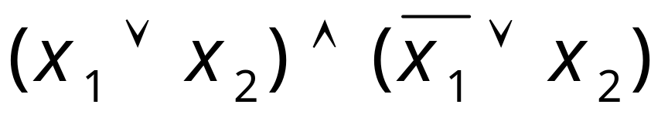
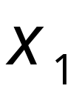
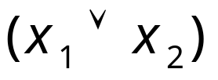
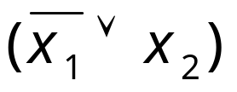
Gadget for
variable
the directions
change
Costas Busch - RPI
Fall 2006

Slide 69
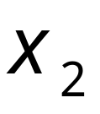
Gadget for
variable
Costas Busch - RPI
Fall 2006

Slide 70
Costas Busch - RPI
Fall 2006

Slide 71
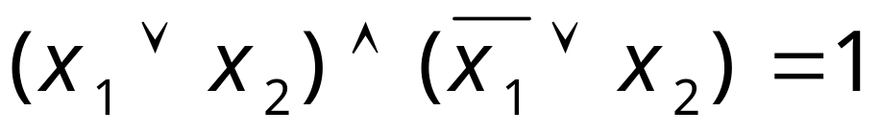
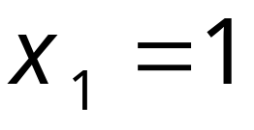
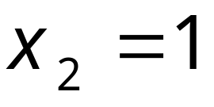
Costas Busch - RPI
Fall 2006

Slide 72
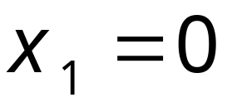
Costas Busch - RPI
Fall 2006

Slide 73
Reduction from Special Case to General Case
Basic reduction strategies.
  Reduction by simple equivalence.
  Reduction by encoding with gadgets.
  Reduction from special case to general case.
    VC->SC
    Hamilton->TSP

Slide 74
Set Cover
SET COVER: Given a set U of elements, a collection S₁, S₂, . . . , S_{m} of subsets of U, and an integer k, does there exist a collection of ≤ k of these sets whose union is equal to U?
Sample application.
  m available pieces of software.
  Set U of n capabilities that we would like our system to have.
  The i^{th} piece of software provides the set S_{i} ⊆ U of capabilities.
  Goal: achieve all n capabilities using fewest pieces of software.
Ex:
U = { 1, 2, 3, 4, 5, 6, 7 }
k = 2
S₁ = {3, 7} S₄ = {2, 4}
S₂ = {3, 4, 5, 6} S₅ = {5}
S₃ = {1} S₆ = {1, 2, 6, 7}

Slide 75
Vertex Cover Reduces to Set Cover
    VC->SC
Claim. VERTEX-COVER ≤ _{P} SET-COVER.
Pf. Given a VERTEX-COVER instance G = (V, E), k, we construct a set cover instance whose size equals the size of the vertex cover instance.
Construction.
  Create SET-COVER instance:
    k = k, U = E, S_{v} = {e ∈ E : e incident to v }
  Set-cover of size ≤ k iff vertex cover of size ≤ k. ▪
VERTEX COVER
a
b
SET COVER
U = { 1, 2, 3, 4, 5, 6, 7 }
k = 2
S_{a} = {3, 7} S_{b} = {2, 4}
S_{c} = {3, 4, 5, 6} S_{d} = {5}
S_{e} = {1} S_{f}= {1, 2, 6, 7}
e₇
e₂
e₃
e₄
f
e₆
c
e₁
e₅
k = 2
e
d

Slide 76
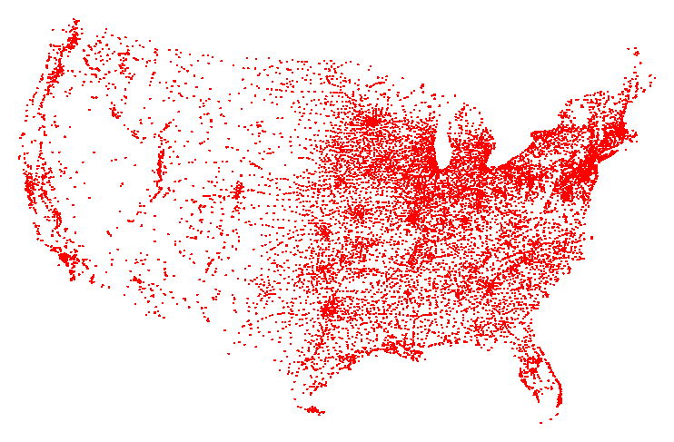
Traveling Salesman Problem
TSP. Given a set of n cities and a pairwise distance function d(u, v), is there a tour of length ≤ D?
All 13,509 cities in US with a population of at least 500
Reference: http://www.tsp.gatech.edu

Slide 77
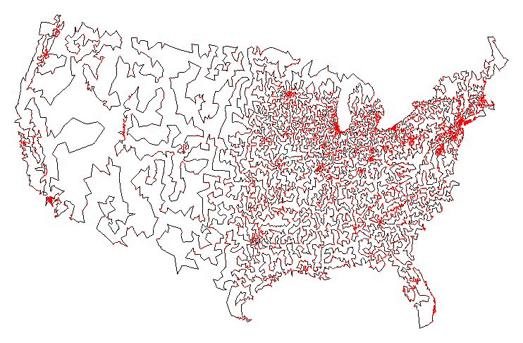
Traveling Salesman Problem
TSP. Given a set of n cities and a pairwise distance function d(u, v), is there a tour of length ≤ D?
Optimal TSP tour
Reference: http://www.tsp.gatech.edu

Slide 78
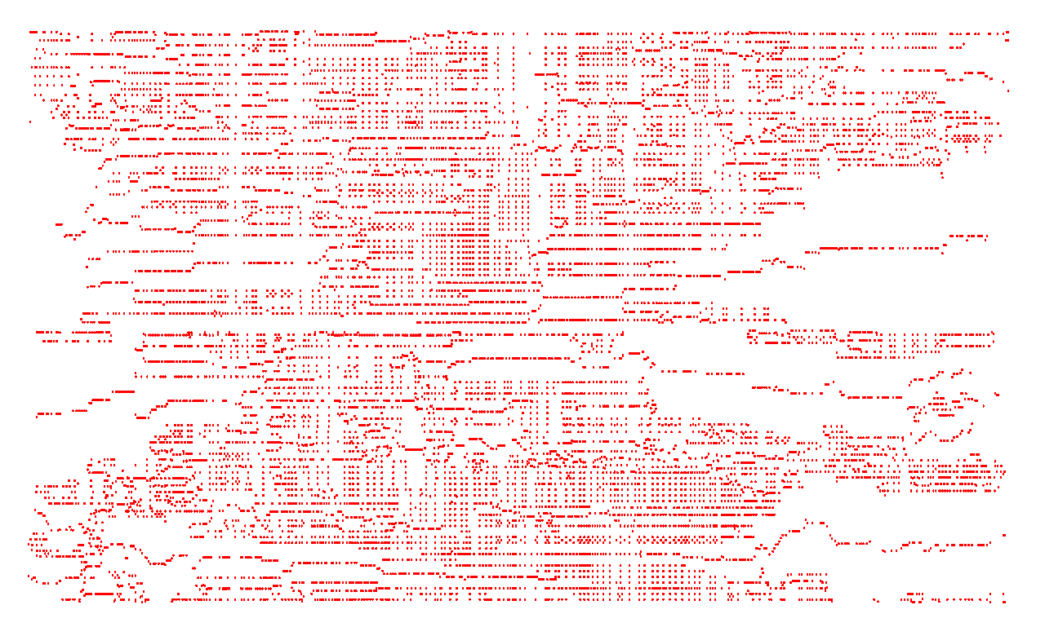
Traveling Salesman Problem
TSP. Given a set of n cities and a pairwise distance function d(u, v), is there a tour of length ≤ D?
11,849 holes to drill in a programmed logic array
Reference: http://www.tsp.gatech.edu

Slide 79
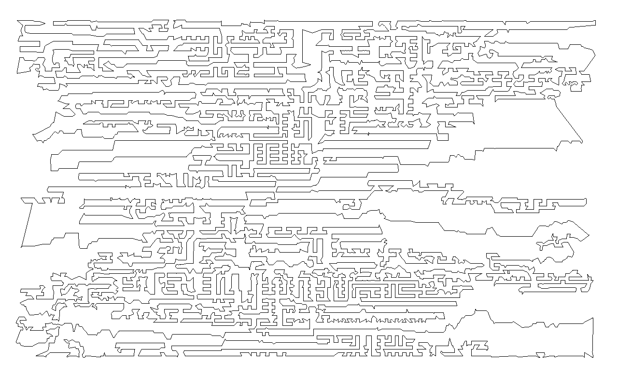
Traveling Salesman Problem
TSP. Given a set of n cities and a pairwise distance function d(u, v), is there a tour of length ≤ D?
Optimal TSP tour
Reference: http://www.tsp.gatech.edu

Slide 80
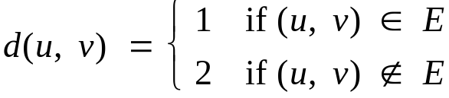
Hamiltonian Cycle Reduces to TSP
HAM-CYCLE ≤ _{P} TSP
TSP. Given a set of n cities and a pairwise distance function d(u, v), is there a tour of length ≤ D?
HAMILTONIAN-CYCLE. given a graph G = (V, E), does there exist a simple cycle that contains every node in V?
Claim. HAM-CYCLE ≤ _{P} TSP.
Pf.
  Given instance G = (V, E) of HAMILTONIAN-CYCLE, create n cities with distance function
  TSP instance has tour of length ≤ n iff G is Hamiltonian. ▪

Slide 81
Other examples
Subset sum → Knapsack
Knapsack → makespan
Subset sum → strip packing

Slide 82
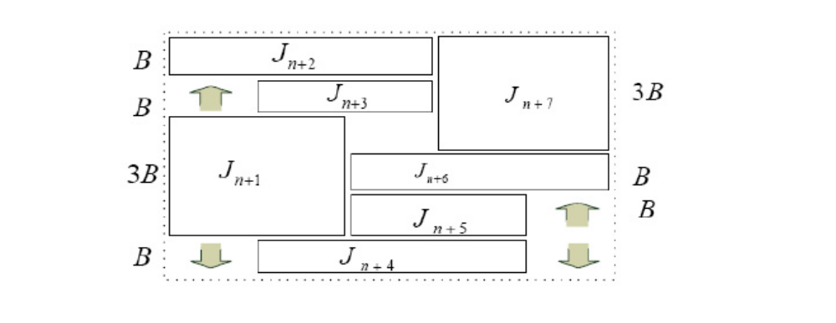
Other examples
Subset sum → Knapsack
Knapsack → makespan
Subset sum → strip packing

Slide 83
Thank U!

Slide 84
Techniques for Proving
NP-Completeness
1. Restriction - Show that a special case of the problem you are interested in is NP-complete. For example:
  The problem of finding a path of length k is a superset of the Hamiltonian Path problem.
  The problem of finding a subgraph of size j where each vertex is at least degree k is an expanded version of the Clique problem
In general, all we need to do is prove part of a problem hard for the entire problem to be classified NP-hard.

Slide 85
2. Local Replacement
Make local changes to the structure. An example is the SAT to SAT-3 reduction. Another example is showing isomorphism is no easier for bipartite graphs:
For any graph, replacing an edge with makes it bipartite.

Slide 86
3. Component Design
These are the ugly, elaborate constructions, such as the ones we use to reduce SAT into vertex cover, and subsequently vertex cover into Hamiltonian Circuit.

Slide 87
The Art of Proving Hardness
Proving that problems are hard is an skill. Once you get the hang of it, it becomes surprisingly straightforward and intuitive.
Indeed, the dirty little secret of NP-completeness proofs is that they are usually easier to recreate than explain, in the same way that it is usually easier to rewrite old code than to try to understand it.
Notes:
How many of you have tried to modify someone else’s code?
How many of you found this to be a happy experience?
What is often easier than trying to understand someone else’s code?

Slide 88
Guideline 1
Make your source problem as simple as possible.
Never try to reduce the general Traveling Salesman Problem to prove hardness. Better, use Hamiltonian Cycle. Even better, don’t worry about closing the cycle, and use Hamiltonian Path.
If you are aware of simpler NP-Complete problems, you should always use them instead of their more complex brethren. When reducing Hamiltonian Path, you could actually demand the graph to be directed, planar or even 3-regular if any of these make an easier reduction.
Notes:
We can only do this because we know that Hamiltonian Path on a directed, planar, 3-regular graph is still NP-Complete, so we might as well have these restrictions.
If we use them, great! If not, they don’t hurt us.
The more restricted your problem is, the easier it will be to reduce.

Slide 89
Guideline 2
Make your target problem as hard as possible.
Don’t be afraid to add extra constraints or freedoms in order to make your problem more general.
Perhaps you are trying to prove a problem NP-Complete on an undirected graph. If you can prove it using a directed graph, do so, and then come back and try to simplify the target, modifying your proof. Once you have one working proof, it is often (but not always) much easier to produce a related one.
Notes:
If I’m trying to prove my problem hard, I should consider it as being as hard as possible!

Slide 90
Guideline 3
Select the right source problem for the right reason.
3-SAT: The old reliable. When none of the other problems seem to work, this is the one to come back to.
Integer Partition: This is the one and only choice for problems whose hardness requires using large numbers.
Vertex Cover: This is the answer for any graph problems whose hardness depends upon selection.
Hamiltonian Path: This is the proper choice for most problems whose answer depends upon ordering.

Slide 91
Guideline 4
Amplify the penalties for making the undesired selection.
If you want to remove certain possibilities from being considered, it may always be possible to assign extreme values to them, such as zero or infinity.
For example, we can show that the Traveling Salesman Problem is still hard on a complete graph by assigning a weight of infinity to those edges that we don’t want used.
Notes:
If I’m trying to optimize two things at once, and I can show that even looking at only ONE of them I can show the problem to be NP-Complete, then I can set all the weights associated to the other one to zero.
3-SAT to vertex cover. We needed to punish ourselves if we didn’t have a true in each and every clause.

Slide 92
Guideline 5
Think strategically at a high level, and then build gadgets to enforce tactics.
You should be asking yourself the following types of questions: “How can I force that either A or B, but not both are chosen?” “How can I force that A is taken before B?” “How can I clean up the things that I did not select?”
After you have an idea of what you want your gadgets to do, you can start to worry about how to craft them. The reduction to Hamiltonian Path is a perfect example.
Notes:
This is the difference between strategy (high level) and tactics (low level).

Slide 93
Guideline 6
When you get stuck, alternate between looking for an algorithm or a reduction.
Sometimes the reason you cannot prove hardness is that there exists an efficient algorithm that will solve your problem! Techniques such as dynamic programming or reducing to polynomial time graph problems sometimes yield surprising polynomial time algorithms.
Whenever you can’t prove hardness, it likely pays to alter your opinion occasionally to keep yourself honest.
Notes:
After failing to prove a problem hard, you will often have a better idea of *why* its not hard, and this can lead us to finding an algorithm.

Slide 94
3-Satisfiability
Instance: A collection of clause C where each clause contains exactly 3 literals, boolean variable v.
Question: Is there a truth assignment to v so that each clause is satisfied?
Note: This is a more restricted problem than normal SAT. If 3-SAT is NP-complete, it implies that SAT is NP-complete but not visa-versa, perhaps longer clauses are what makes SAT difficult?
1-SAT is trivial.
2-SAT is in P (you will prove this in your last homework)

Slide 95
3-SAT
Theorem: 3-SAT is NP-Complete
Proof:
  1) 3-SAT is NP. Given an assignment, we can just check that each clause is covered.
  2) 3-SAT is hard. To prove this, a reduction from SAT to 3-SAT must be provided. We will transform each clause independently based on its length.

Slide 96
Reducing SAT to 3-SAT
Suppose a clause contains k literals:
if k = 1 (meaning C_{i} = {z₁} ), we can add in two new variables v₁ and v₂, and transform this into 4 clauses:
  {v₁, v₂, z₁} {v₁, ¬v₂, z₁} {¬v₁, v₂, z₁} {¬v₁, ¬v₂, z₁}
if k = 2 ( C_{i} = {z₁, z₂} ), we can add in one variable v₁ and 2 new clauses: {v₁, z₁, z₂} {¬v₁, z₁, z₂}
if k = 3 ( C_{i} = {z₁, z₂, z₃} ), we move this clause as-is.
Notes:
if (k = 1), all of these must be true.
Alternatively, we can process all of the clauses of size one first, and remove them from the problem.
If course, 1 through 3 we’d expect to be easy to translate. What do we do for k larger than 3?

Slide 97
Continuing the Reduction….
if k > 3 ( C_{i} = {z₁, z₂, …, z_{k}} ) we can add in k - 3 new variables (v₁, …, v_{k-3}) and k - 2 clauses:
{z₁, z₂, v₁} {¬v₁, z₃, v₂} {¬v₂, z₄, v₃} … {¬v_{k-3}, z_{k-1}, z_{k}}
Thus, in the worst case, n clauses will be turned into n² clauses. This cannot move us from polynomial to exponential time.
If a problem could be solved in O(n^{k}) time, squaring the number of inputs would make it take O(n^{2k}) time.
Notes:
If none of the original variables are true, its not possible to make all of the 3-SAT clauses true using only the new variables that we added in.
If any original literal IS true, we now have n-3 remaining clauses and n-3 free variables.
In the last paragraph, k is a constant.

Slide 98
Generalizations about SAT
Since any SAT solution will satisfy the 3-SAT instance and a 3-SAT solution can set variables giving a SAT solution, the problems are equivalent. If there were n clauses and m distinct literals in the SAT instance, this transform takes O(nm) time, so SAT == 3-SAT.
Note that a slight modification to this construction would prove 4-SAT, or 5-SAT, ... also NP-complete.
Having at least 3-literals per clause is what makes the problem difficult.
Notes:
Now that we have shown 3-SAT is NP-complete, we may use it for further reductions.
Since the set of 3-SAT instances is smaller and more regular than the SAT instances, it will be easier to use 3-SAT for future reductions.
Remember the direction to reduction!
Would SAT still be hard if we used Disjunctive Normal Form?

Slide 99
Integer Programming
Instance: A set v of integer variables, a set of inequalities over these variables, a function f(v) to maximize, and integer B.
Question: Does there exist an assignment of integers to v such that all inequalities are true and f(v) ≥ B?
Example:
  v₁ ≥ 1, v₂ ≥ 0
  v1 + v2 ≤ 3
  f(v) = 2v₂ ; B = 3
Notes:
Lets now look at a very different problem.
Various sorts of constraint problems are just integer programming. I.e. Airline Schedules, setting up investments
Another way of looking at this problem is just as a selection of inequalities, and we need to find a set of integers to make them all true.
If B=5, this would be false.

Slide 100
Is Integer Programming NP-Hard?
Theorem: Integer Programming is NP-Hard
Proof: By reduction from Satisfiability
Any SAT instance has boolean variables and clauses. Our Integer programming problem will have twice as many variables, one for each variable and its compliment, as well as the following inequalities:
  0 ≤ v_{i} ≤ 1 and 0 ≤ ¬v_{i} ≤ 1
  1 ≤ v_{i} + ¬v_{i} ≤ 1
  for each clause C = {v₁, ¬v₂, ... v_{i}} : v₁+ ¬v₂+…+ v_{i} ≥ 1

Slide 101
We must show that:
1. Any SAT problem has a solution in IP.
In any SAT solution, a TRUE literal corresponds to a 1 in IP since, if the expression is SATISFIED, at least one literal per clause is TRUE, so the inequality sum is > 1.
2. Any IP solution gives a SAT solution.
Given a solution to this IP instance, all variables will be 0 or 1. Set the literals corresponding to 1 as TRUE and 0 as FALSE. No boolean variable and its complement will both be true, so it is a legal assignment with also must satisfy the clauses.

Slide 102
Things to Notice
1. The reduction preserved the structure of the problem. Note that reducing the problem did not solve it - it just put the problem into a different format.
2. The IP instances that can result are a small subset of possible IP instances, but since some of them are hard, the problem in general must be hard.

Slide 103
More Things to Notice
3. The transformation captures the essence of why IP is hard - it has nothing to do with big coefficients or big ranges on variables; restricting to 0/1 is enough. A reduction tells us a lot about a problem.
4. It is not obvious that IP is in NP, since the numbers assigned to the variables may be too large to write in polynomial time - don't be too hasty! Couldn’t maximizing a function could drive some unbounded variables to extreme values?
Notes:
In fact, integer programming IS in NP, this is just an example of a problem that it may be harder to show this than to prove that the problem is hard.

Slide 104
The Independent Set Problem
Problem: Given a graph G = (V, E) and an integer k, is there a subset S of at least k vertices such that no e ∈ E connects two vertices that are both in S ?
Theorem: Independent Set is NP-complete.
Proof: Independent Set is in NP - given any subset of vertices, we can count them, and show that no vertices are connected.
How can we prove that it is also a hard problem?

Slide 105
Reducing 3-SAT to Independent Set
For each variable, we can create two vertices:
…
v₁ ¬v₁
v₂ ¬v₂
v₃ ¬v₃
v_{n} ¬v_{n}
If we connect a variable and its negation, we can be sure that only one of them is in the set. In all, we must have n vertices in S to be sure all variables are assigned.
This will handle the binary true-false values; how can we also make sure that all of the clauses are fulfilled?

Slide 106
Including Clauses in the Reduction
…
v₁ ¬v₁
v₂ ¬v₂
v₃ ¬v₃
v_{n} ¬v_{n}
We can consider the clauses as triangles:
v₁
v₂
¬v₄
v₃ ¬v₇
¬v₃ ¬v₄
v₅ v₆
Each clause has at least one true value. On the other hand, at most one vertex in a triangle can be in the independent set. So how do we tie these together?

Slide 107
Tying it all together...
C = {¬v₁, v₂, ¬v₃} , {v₁, ¬v₂, ¬v₄} ,
{¬v₂, ¬v₄, v₅} , {v₃, v₄, v₅}
v₁ ¬v₁
v₂ ¬v₂
v₃ ¬v₃
v₄ ¬v₄
v₅ ¬v₅
v₂
v₁
¬v₂
v₃
¬v₁ ¬v₃
¬v₂ ¬v₄
¬v₄ v₅
v₄ v₅
Notes:
If there are n variables and m clauses, then finding the satisfiability is the same as finding n+m independent vertices.
This is the maximum possible number of independent vertices.
Can we convert any set of clauses? How long will it take?
How do we convert the results back?

Slide 108
Hamiltonian Cycle
Problem: Given a graph G, does it contain a cycle that includes all of the vertices in G?
Theorem: Hamiltonian Cycle is NP-complete.
Proof: Hamiltonian cycle is in NP - given an ordering on the vertices, we can show that and edge connecting each consecutive pair, and then the final vertex connecting back to the first
We now have some graph problems to work with, but how can they really help us with this problem?
Notes:
This problem is intimately related to the Traveling Salesman

Slide 109
The Reduction
For every edge in the Minimum Vertex Cover problem, we must reduce it to a “contraption” in the Hamiltonian Cycle Problem:
u
v
u
v
u′
v′
Notes:
DON’T PANIC!!!!
Don’t worry right now about what this does. It’s a contraption we’re going to use in this proof, and I’m going to show you some interesting properties about it now.
Also, I will NOT test you on this proof. This is just an example of what some of these harder proofs look like (well, maybe as an extra credit, but probably not).

Slide 110
Observations….
u
v
u
v
u
v
u′
v′
u′
v′
u′
v′
There are only three possible ways that a cycle can include all of the vertices in this contraption.
Notes:
Note: If a path enters on v, it leaves on v’. If it enters on u, it leaves on u’.
It may or may not deal with all of the vertices on the other side in the process.

Slide 111
Joining Contraptions
u
v
All components that represent edges connected to u are strung together into a chain.
If there are n vertices, then we will have n of these chains, all interwoven.
The only other changes we need to make are at the ends of the chains. So what do we have?
u′
v′
w
u
w′
u′
u
x
u′
x′

Slide 112
y
v
u
w
y′
v′
u′
w′
v
u
y
w
v
u
z
x
v′
u′
z
v
u
x
z′
v′
u′
x′
Notes:
Notice: Five Edges => new graph has five contraptions.
Each included chain must either go the entire length, or not at all. There are a total of n chains
We only need to include those chains that are in a cover. For example, v, w, x is a cover.
For each edge, either one or both vertices must be in the cover.

Slide 113
Tying the Chains Together
If we want to know if its possible to cover the original graph using only k vertices, this would be the same as seeing if we can include all of the vertices using only k chains.
How can we include exactly k chains in the Hamiltonian Cycle problem?
We must add k extra vertices and connect each of them to the beginning and end of every chain. Since each vertex con only be included once, this allows k chains in the final cycle.

Slide 114
Beginning a Transform

Slide 115
The Final Transform

Slide 117
Appendix
The following slides are from a document by Dr. Robins, University of Virginia

Slide 118
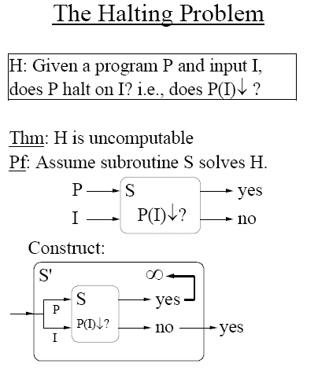

Slide 119
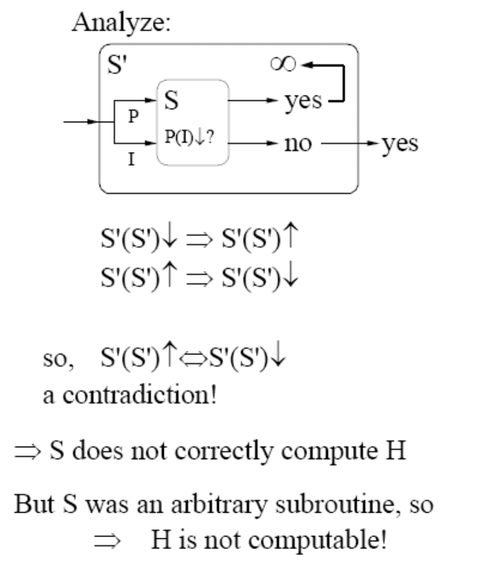

Slide 120
Halting Problems
Halting problem.
  Devise a TM that reads in another TM (encoded in binary) and its initial tape, and determine whether or not that TM would ever reach a yes or no state.
  Write a C program that reads in another program and its inputs, and decides whether or not it goes into an infinite loop.
Theorem (Alan Turing, 1937). Halting problem is undecidable.
  No TM can solve the halting problem. (not possible to write a C program either)
Proof intuition.
  Self-reference.
Notes:
paradox：悖论

Slide 121
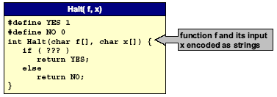
Halting Problem Proof
Assume the existence of Halt(f,x) that takes as input: any function f and its input x, and outputs yes if f(x) halts, and not otherwise.
  We prove Halt(f,x) can’t exist by contradiction.
  Note: Halt(f,x) always returns yes or no.
  (infinite loop not possible)

Slide 122
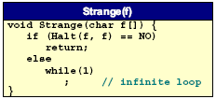
Halting Problem Proof
Assume the existence of Halt(f,x) that takes as input: any function f and its input x, and outputs yes if f(x) halts, and not otherwise.
  Construct program Strange(f) as follows:.
    calls Halt(f,f)
    halts if Halt(f,f) outputs no
    goes into infinite loop if Halt(f,f) outputs yes
  In other words:
    if f(f) does not halt then Strange(f) halts
    if f(f) halts then Strange(f) does not halt

Slide 123
Halting Problem Proof
Assume the existence of Halt(f,x) that takes as input: any function f and its input x, and outputs yes if f(x) halts, and not otherwise.
  Construct program Strange(f) as follows:.
    calls Halt(f,f)
    halts if Halt(f,f) outputs no
    goes into infinite loop if Halt(f,f) outputs yes
  In other words:
    if f(f) does not halt then Strange(f) halts
    if f(f) halts then Strange(f) does not halt
  Call Strange with ITSELF as input.
    if Strange(Strange) does not halt then Strange (Strange) halts
    if Strange(Strange) halts then Strange (Strange) does not halts
  Either way, a contradiction. Hence Halt(f,x) cannot exist.

Slide 124
Consequences
Halting problem is “not artificial.”
  Undecidable problem reduced to simplest form to simplify proof.
  Closely related to practical problems.
  Hilbert’s 10th problem, Post’s correspondence problem, program equivalence, optimal data compression
How to show new problem X is undecidable?
  Use fact that Halting problem is undecidable.
  Design algorithm to solve Halting problem, using (alleged) algorithm for X as a subroutine.
  Reduction
Notes:
alleged：所谓的

Slide 125
NP-hard
Hamilton cycle
Steiner tree
Graph 3-coloring
Satisfiability
Maximum clique
…
NP-complete
Matrix permanent
Halting problem
…
NP
Factoring
Graph isomorphism
Minimum circuit size
…
Graph connectivity
Primality testing
Matrix determinant
Linear programming
…
P

Slide 126
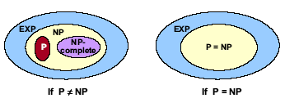
Implications of Universal Turing Machine
Definition of NP-complete:
  A problem in NP with the property that if it can be solved efficiently, then it can be used as a subroutine to solve any other problem in NP efficiently.
  “Hardest computational problems” in NP.

